Slide 1
Final Project: Data Science Salaries
Patrick Redington
DSC530-T302

Slide 2
Data Science Salaries EDA/Regression Goals
Overall goal is to discover what variables affect the salary of a position.
Including how experience level, remote work ratio, company size, and the company’s location affect the positions salary.
Using these variables and others can a regression be built that can accurately predict salaries.

Slide 3
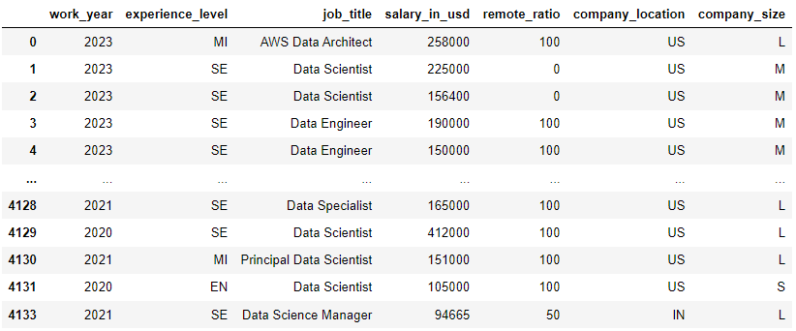
Data Set – Data Science Salaries
The data set was obtained from Kaggle and is available for public domain use.
Data was acquired from worldwide contributors and has been updated weekly since 2020.
Summary of the data set is below.

Slide 4


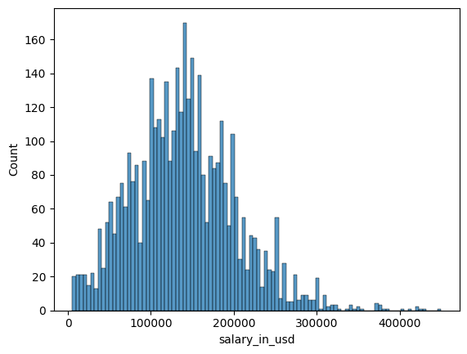
Salary in usd
States the salary reported converted to USD, if not reported as USD already.
Statistics:
count 4093.000000
mean 140116.351332
std 62983.078569
variance 3966868186
min 5132.000000
25% 99050.000000
50% 136000.000000
75% 180000.000000
max 450000.000000
Name: salary_in_usd
dtype: float64

Slide 5
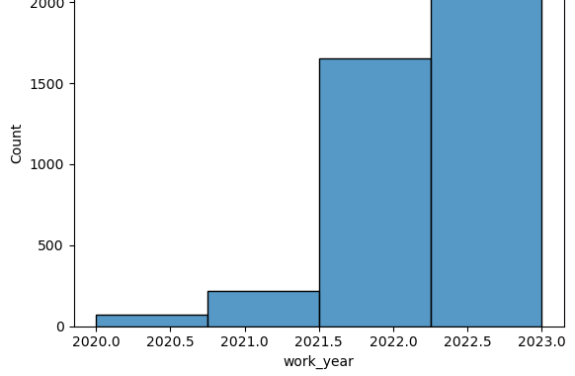
Work Year
States the year the salary was paid to the employee.
Statistics:
count 4093.000000
mean 2022.437332
std 0.676584
variance 0.457765
min 2020.000000
25% 2022.000000
50% 2023.000000
75% 2023.000000
max 2023.000000
Name: work_year
dtype: float64

Slide 6
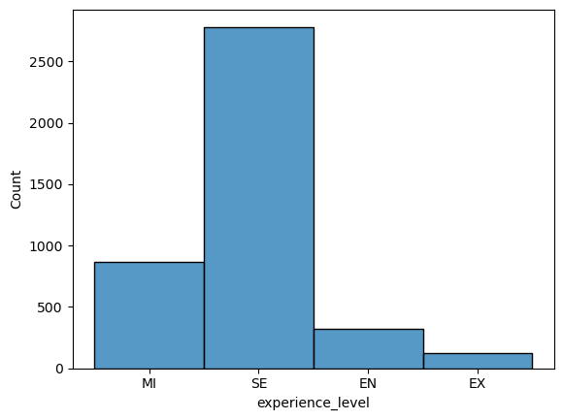
Experience level
States the experience level of the position ; EN (Entry-level), MI (Mid-level), SE (Senior-level), and EX (Executive-level).
Statistics:
count 4093
unique 4
variance 0.440626
top SE
freq 2784
Name: experience_level
dtype: object

Slide 7
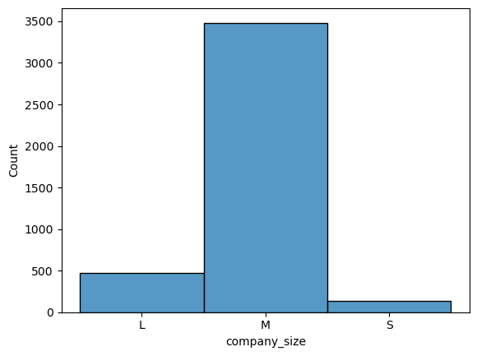
Company size
The average number of people that worked for the company during the year: S (less than 50) M (50 to 250) L (more than 250).
Statistics:
count 4093
unique 3
variance 0.14212
top M
freq 3484
Name: company_size
dtype: object

Slide 8
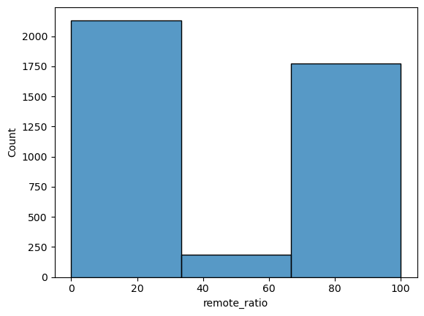
Remote ratio
States the amount of remote work; 0 (less than 20%) 50 (20%-80%) 100 (more than 80%).
Statistics:
count 4093.000000
mean 45.614464
std 48.671951
variance 0.236895
min 0.000000
25% 0.000000
50% 0.000000
75% 100.000000
max 100.000000
Name: remote_ratio
dtype: float64

Slide 9
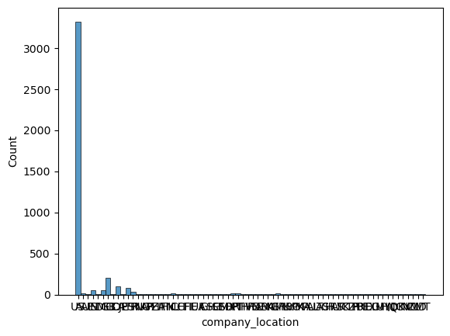
Company location
Sates the country of the employer's main office or contracting branch as an ISO 3166 country code.
Statistics:
count 4093
unique 70
variance 297.09829
top US
freq 3326
Name: company_location
dtype: object

Slide 10
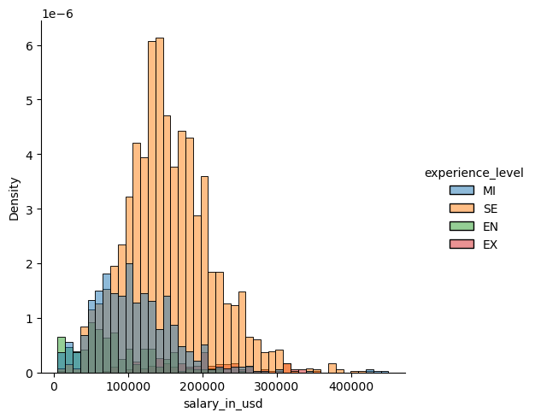
PMF –Salary compared by experience levels
Majority of data points are from senior level positions.
As expected, the higher the level of experience of the position the father salary probability is pushed to the right on the pay scale.
Means:
EN - $80,192.33
MI - $107,652.77
SE - $154,698.15
EX - $193,833.15

Slide 11
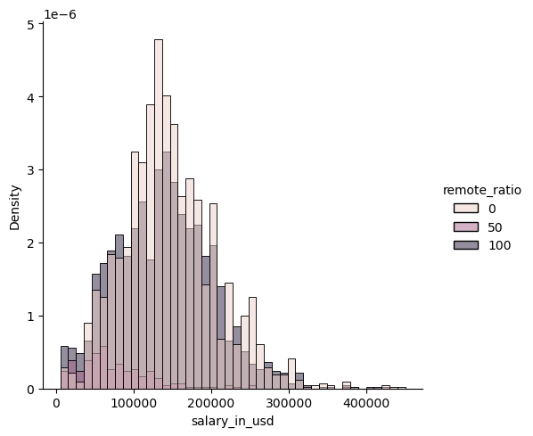
PMF- Salaries compared by remote work ratio
Majority of data points come either 0% remote work or 100%.
Hybrid work seems to be on the lower end of the pay range.
0% vs 100% seems to be normally distributed across the pay range.

Slide 12
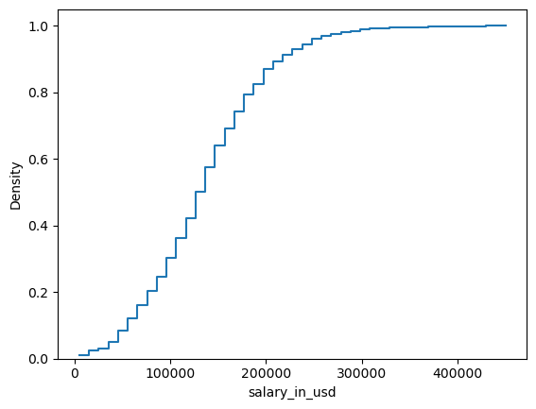
CDF- Reported Salary
Around 60% of the salaries are between 100K and 200K. With a somewhat linear distribution in this range.
After 200K the distribution begin to level out.
Less than 5-7% make below 50K, which may be due to bad data or third world countries.

Slide 13
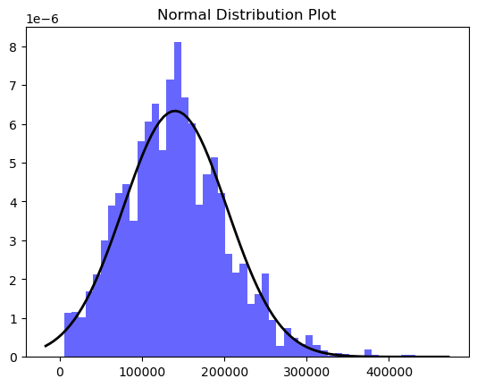
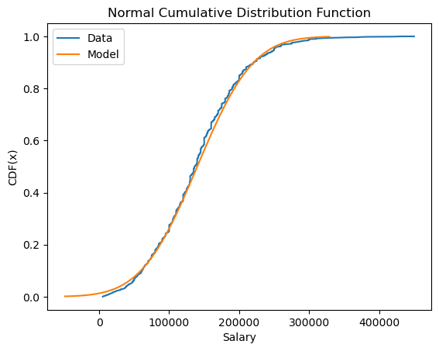
Distribution
The salaries are mostly normal distributed.
As can be seen in the distribution plot and the CDF plot comparing it against the model.
There is deviation on the lower end, as expected from the original CDF. Which may be cause by bad data or a few outliers.
The data also increases quicker in the middle that may be an affect caused by the lower end data.

Slide 14
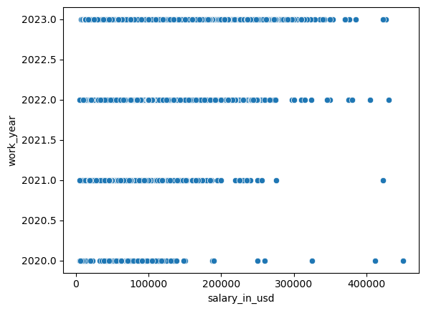
Scatter Plots: Salary Vs. Work year
The data points increase over the years, but there is a clear trend to the right as the years progress.
There is a correlation of 0.230 as well which shows there is some correlation even if minor.
This is expected due to the overall wage increases over the years and the increase in demand for data scientist.

Slide 15
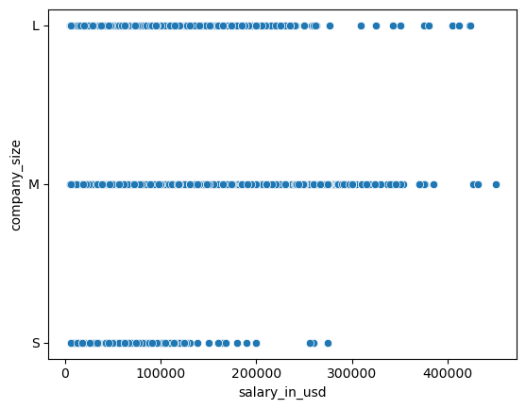
Scatter Plots: Salary Vs. Company Size
The majority of the data points are from medium and large companies.
There initially looks to be a correlation between small and medium/large companies on pay ranges.
The actual correlation is -0.005 though, so this just looks like there is due to the distribution of the data.

Slide 16
Hypothesis Test – Pearson correlation
Hypothesis 1 – The amount of remote work affects the employee’s salary.
After 1000 iterations the largest correlation was -0.121 and the largest P-value was 0.690.
Due to the low correlation and rather large P-Value the correlation coefficient is not statistically significant.
Hypothesis 2 – The employee’s experience level affects their salary.
After 1000 iterations the largest correlation was 0.470 and the largest P-value was 5.25e-72
The correlation is rather large, and the P-value is extremely low. So, the correlation coefficient is statistically significant.

Slide 17
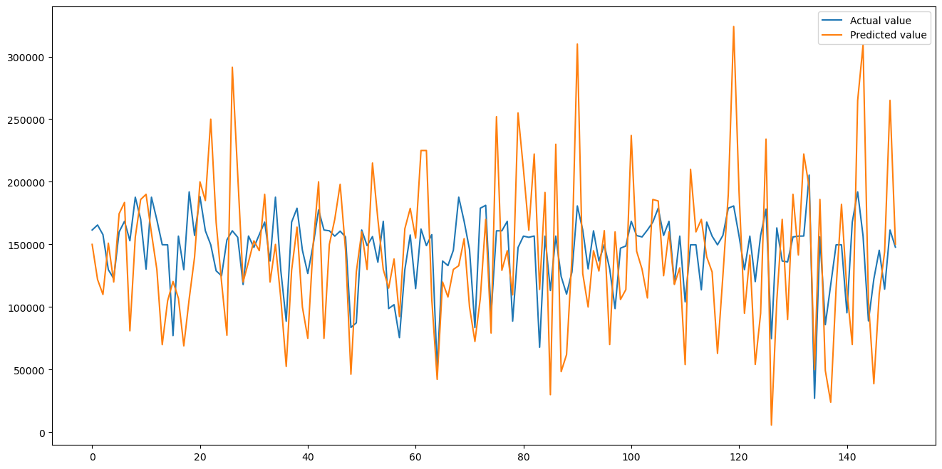
Linear Regression Model
R-Squared = 0.297
MAE = 40962.34
Overall model is not a good fit and only explains 29% of the variances.

Slide 18
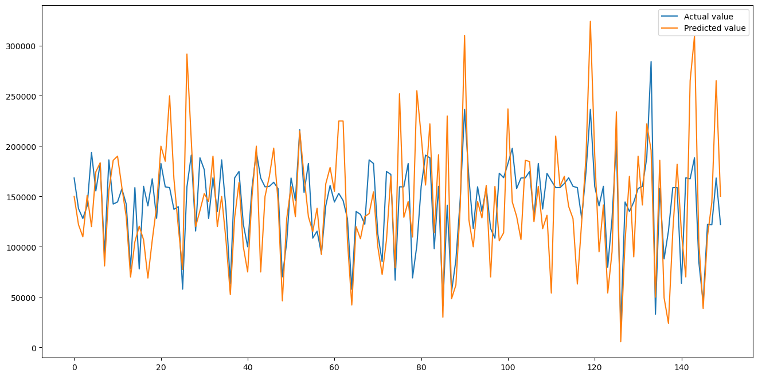
Random Forest Regression Model
R-Squared = 0.560
MAE = 36727.56
Random forest model still isn’t acceptable but drastically better than the linear regression with 56% of the variances accounted for.

